Slide 1
Online Course Recommendation
Course Code:-P-530
Group-5

Slide 2
Online Course Recommendation
The goal of this dataset is to build an online course recommendation system that suggests relevant courses to learners based on their past behavior, preferences, and other features.
Overview of the Dataset Each row in the dataset represents a user's interaction with a course—so it combines both user-specific and course-specific data.

Slide 3
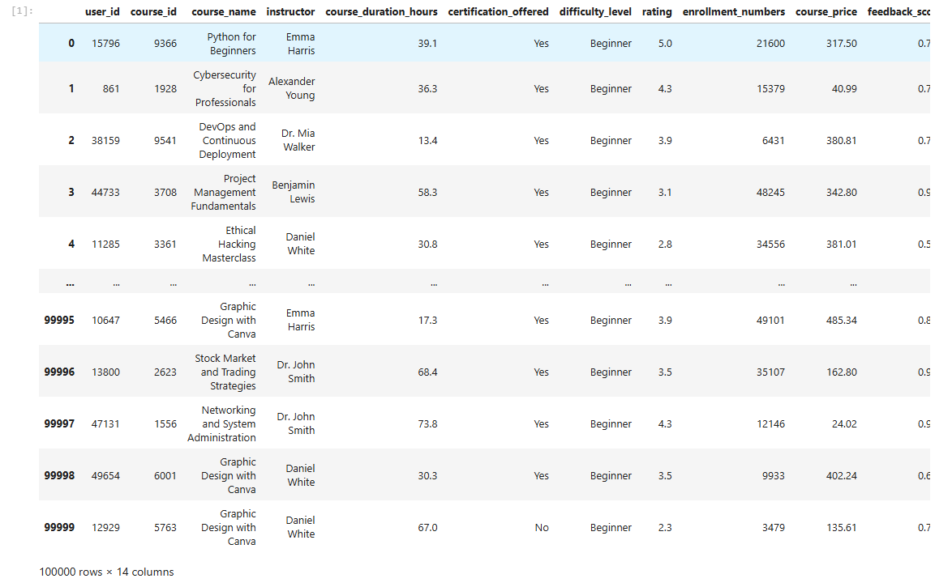
Data Set

Slide 4
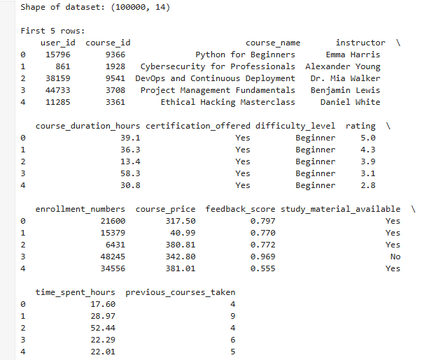
Shape of dataset

Slide 5
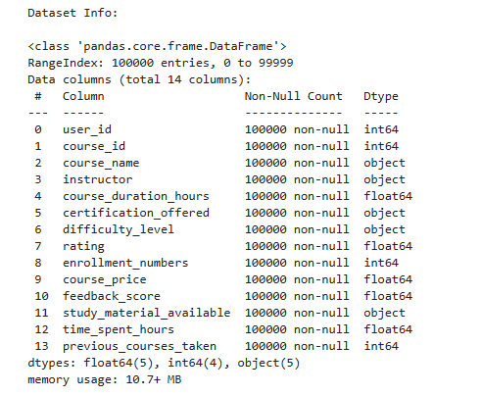
Data Information

Slide 6
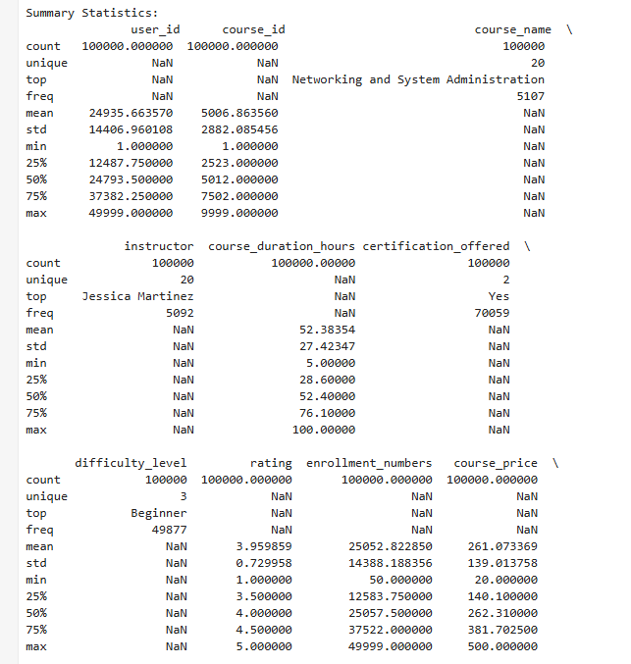
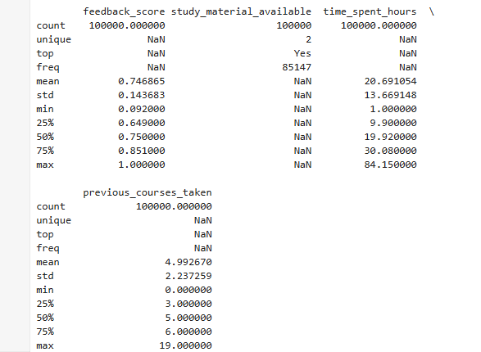
Statistical Summary of Dataset

Slide 7
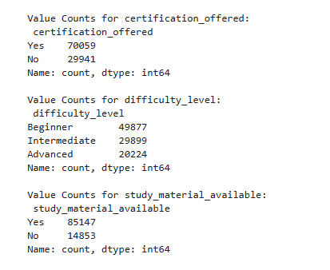
Value Counts of Categorical Data

Slide 8
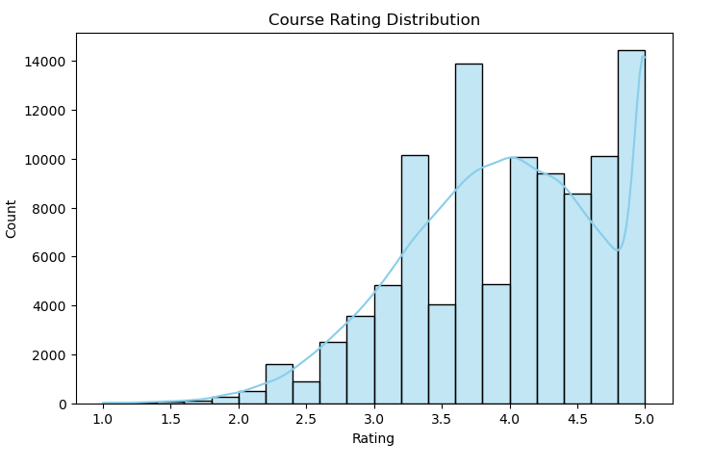
Course Rating Distribution

Slide 9
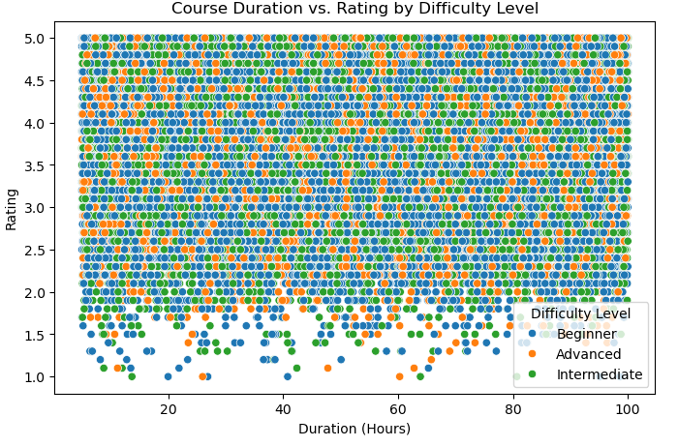
Course Duration vs. Rating by Difficulty Level

Slide 10
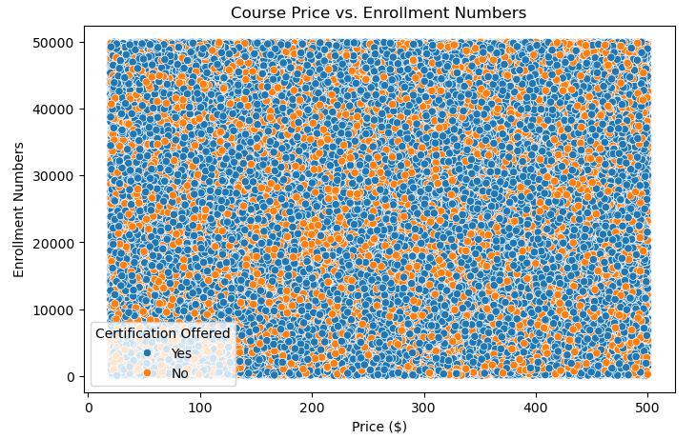
Course Price Vs. Enrollment Numbers

Slide 11
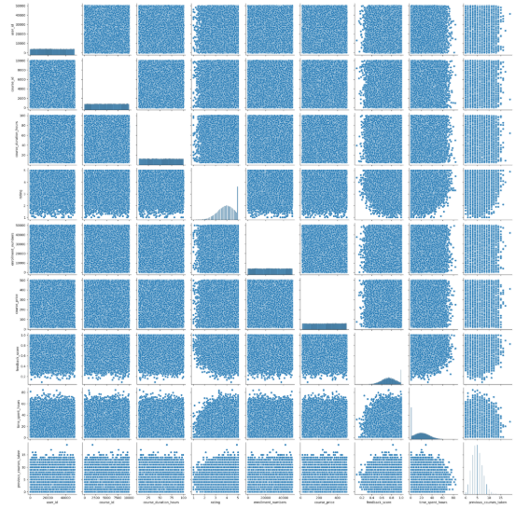
Summarization of dataset

Slide 12
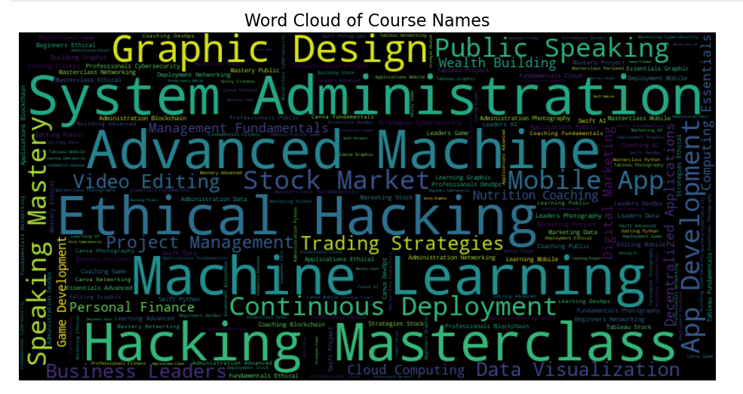
Word Cloud Of Course Names

Slide 13
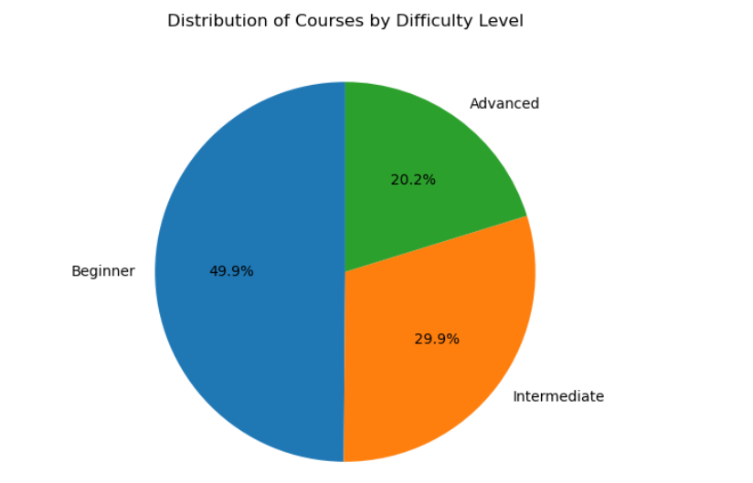
Distribution of Courses By Difficulty Level

Slide 14
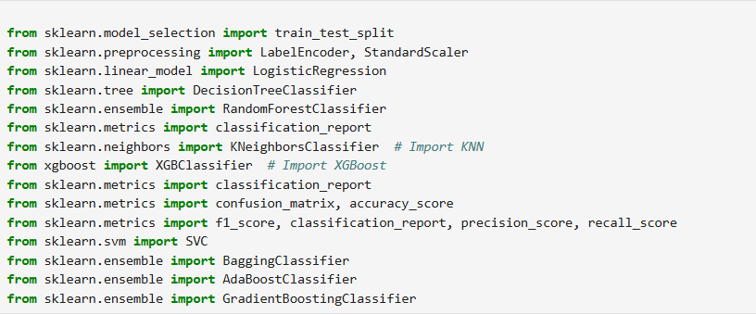
Libraries used for Model Building

Slide 15
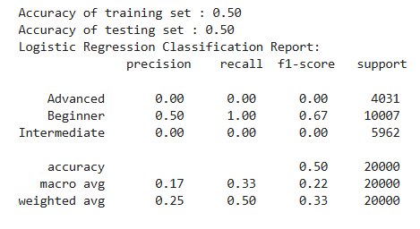
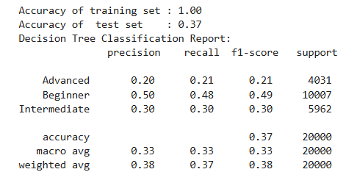
Logistic Regression
Decision Tree

Slide 16
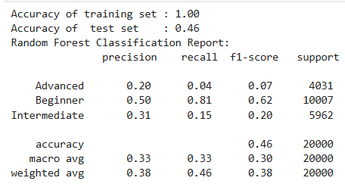
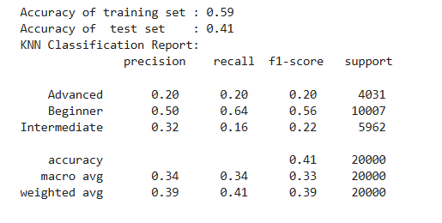
Random Forest
KNN (K-NEAREST NEIGHBORS)

Slide 17
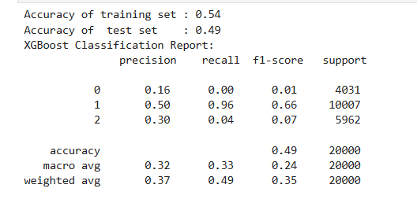
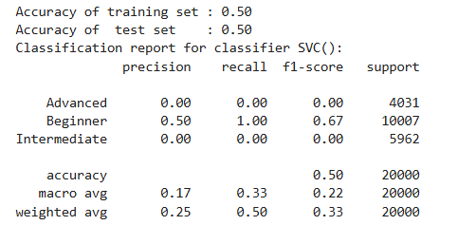
XGBOOST
SUPPORT VECTOR MACHINE

Slide 18
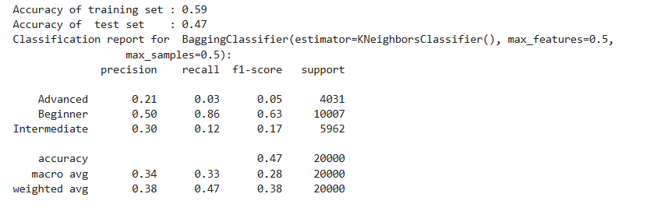
BAGGING CLASSIFICATION

Slide 19
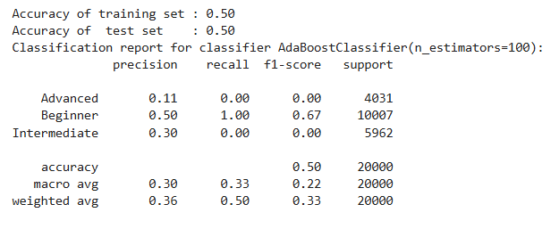
ADA BOOST CLASSIFICATION

Slide 20
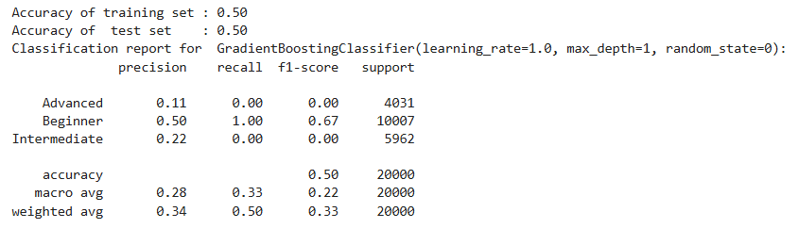
GRADIENT BOOSTING

Slide 21
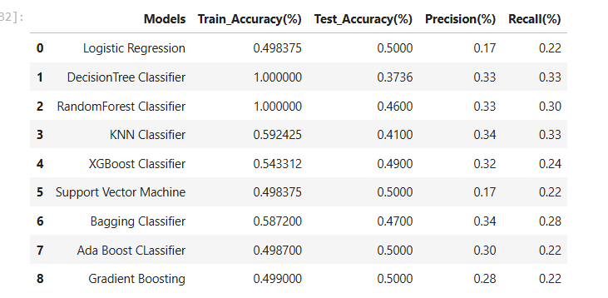
CLASSIFICATION MODELS ACCURACY

Slide 22
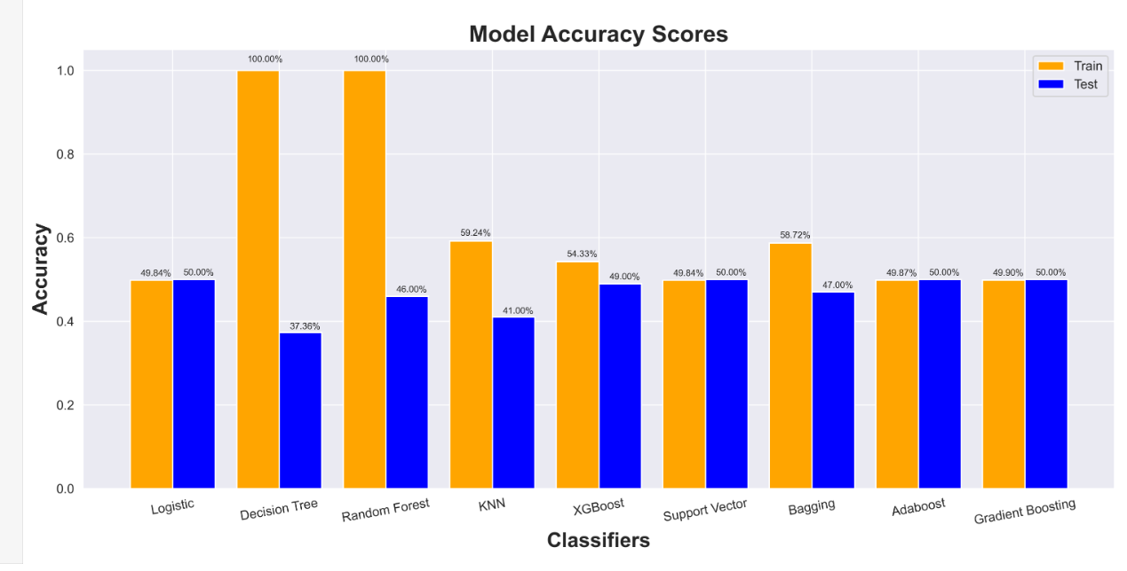

Slide 23
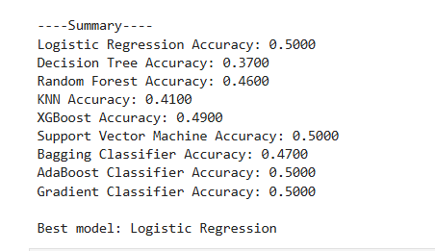
HYPER PARAMETER TUINING

Slide 24
thank you

